Slide 1
SQL: Basic Queries
Database Systems
Department of Computer Science, CBNU
Prof. Nasridinov Aziz (aziz@chungbuk.ac.kr)

Slide 2
Table of Contents
SQL Overview
Data Definition Language
Data Manipulation Language
Summary and Discussions

Slide 3
Last Lecture
Relational Model
  Relational model represents the database as a collection of relations
    Relation = table
  Basic Terminologies
    Relation
    Tuple
    Attribute
    Degree
    Cardinality
    Domain
    Relation Schema
    Relation Instance
    Relational Database Schema
    NULL value

Slide 4
Last Lecture
Characteristics of relational model
Keys
  Super key, Candidate key, Primary key, Alternate key, Foreign key
Integrity constraints
  A set of rules used to ensure the accuracy and consistency of the relational database
  Types of integrity constraints
    Key constraint
    Domain constraint
    Referential integrity constraint

Slide 5
1. SQL Overview
Structural Query Language (SQL)
  Define queries to access and manipulate the data from database
  A procedural language, not a programming language
  A standard language for RDBMS
    Oracle, MySQL, Microsoft SQL and others
  SQL statements are divided into four major categories
    Data Definition Language (DDL)
    Data Manipulation Language (DML)
    Data Control Language (DCL)
    Transaction Control Language (TCL)

Slide 6
1. SQL Overview
SQL basic syntax
  SQL keywords are NOT case sensitive
    select is the same as SELECT
  Comments
    Single line comments: -- (Put the space after --) or #
    Multi-line comments: text between /* and */
  Use semicolon (;) to separate each SQL statement in a database
  List of reserved SQL keywords
    https://www.w3schools.com/sql/sql_ref_keywords.asp

Slide 7
2. Data Definition Language
Data Definition Language (DDL)
  Notation for defining the database schema
    Used to create and modify the structure of your relations and database objects
  Statements
    CREATE
    DROP
    ALTER
    TRUNCATE

Slide 8
2. Data Definition Language
Create database
  Syntax
    CREATE DATABASE databasename;
  Example
    CREATE DATABASE testDB;
  You can check a list of databases using the following SQL statement
    SHOW DATABASES;

Slide 9
2. Data Definition Language
Drop an existing database
  Syntax
    DROP DATABASE databasename;
  Example
    DROP DATABASE testDB;
Set as default schema
  Syntax
    USE databasename;
  Example
    USE testDB;

Slide 10
2. Data Definition Language
Create relation
  Syntax
    CREATE TABLE relation_name(
    attribute1 datatype,
    attribute2 datatype,
    attribute3 datatype,
    … …
    );
  Full list of MySQL Data Types
    https://www.w3schools.com/MySQL/mysql_datatypes.asp

Slide 11

2. Data Definition Language
Create relation
  Example
    CREATE TABLE department(
    deptno int,
    deptname varchar(45),
    floor int
    );
    The empty DEPARTMENT relation will now look like this:

Slide 12
2. Data Definition Language
Drop an existing relation in a database
  Syntax
    DROP TABLE relation_name;
  Example
    DROP TABLE department;
Delete the data inside a relation, but not the relation itself
  Syntax
    TRUNCATE TABLE relation_name;
  Example
    TRUNCATE TABLE department;

Slide 13
2. Data Definition Language
Alter relation – Add attribute
  Syntax
    ALTER TABLE relation_name
    ADD attribute_name datatype;
  Example
    ALTER TABLE department
    ADD phonenumber varchar(45);

Slide 14
2. Data Definition Language
Alter relation – Drop attribute
  Syntax
    ALTER TABLE relation_name
    DROP COLUMN attribute_name;
  Example
    ALTER TABLE department
    DROP COLUMN phonenumber;

Slide 15
2. Data Definition Language
Alter relation – Change attribute name
  Syntax
    ALTER TABLE relation_name
    CHANGE old_attribute_name new_attribute_name datatype;
  Example
    ALTER TABLE department
    CHANGE deptname departmentname varchar(45);

Slide 16
2. Data Definition Language
Alter relation – Modify attribute
  Syntax
    ALTER TABLE relation_name
    MODIFY COLUMN attribute_name datatype;
  Example
    ALTER TABLE department
    MODIFY COLUMN floor varchar(45);

Slide 17
2. Data Definition Language
MySQL constraints
  SQL constraints are used to specify rules for the data in a relation
  MySQL constraints
    NOT NULL
    PRIMARY KEY
    FOREIGN KEY
    UNIQUE
    CHECK
    DEFAULT
    CREATE INDEX

Slide 18
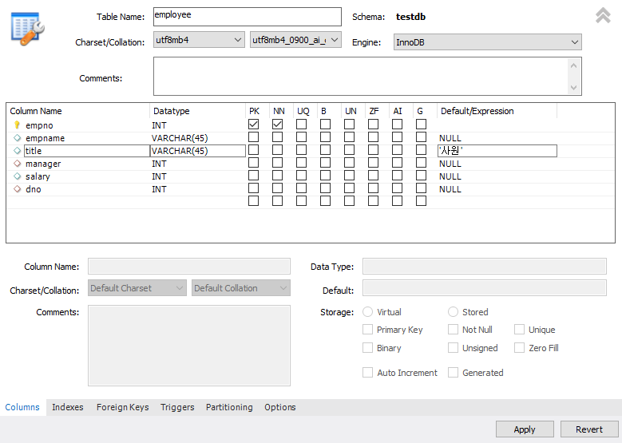
2. Data Definition Language
MySQL Constraints in MySQL Workbench

Slide 19
2. Data Definition Language
MySQL constraints
  Constraints can be specified when the relation is created with the CREATE TABLE statement
  You can also specify constraints after the relation is created with the ALTER TABLE statement
  Syntax
    CREATE TABLE relation_name(
    attribute1 datatype constraint,
    attribute2 datatype constraint,
    attribute3 datatype constraint,
    … …
    );

Slide 20
2. Data Definition Language
NOT NULL constraint
  By default, an attribute can hold NULL values
    The NOT NULL constraint enforces an attribute to NOT accept NULL values
  Example
    CREATE TABLE department(
    deptno int NOT NULL,
    deptname varchar(45) NOT NULL,
    floor int
    );
  Example
    ALTER TABLE department
    MODIFY floor int NOT NULL;

Slide 21
2. Data Definition Language
PRIMARY KEY constraint
  The PRIMARY KEY constraint uniquely identifies each tuple in a relation
  Primary keys must contain unique values, and cannot contain NULL values
  Example
    CREATE TABLE department(
    deptno int NOT NULL,
    deptname varchar(45) NOT NULL,
    floor int,
    CONSTRAINT PK_Department PRIMARY KEY (deptno)
    );

Slide 22
2. Data Definition Language
PRIMARY KEY constraint
  You can also drop PRIMARY KEY constraint
    ALTER TABLE department
    DROP PRIMARY KEY;
  To create a PRIMARY KEY constraint on the “deptno” attribute when the relation is already created
    ALTER TABLE department
    ADD CONSTRAINT PK_Department PRIMARY KEY (deptno);

Slide 23
2. Data Definition Language
FOREIGN KEY constraint
  Used to create a relationship between two relations
  Types of foreign key
    Foreign key referencing the primary key of another relation
    Foreign key referencing the primary key of its own relation
    Foreign key that is a composite of the primary keys
  The relation with the foreign key is called the referencing relation (or child relation), and the relation with the primary key is called the referenced relation (or parent relation)

Slide 24
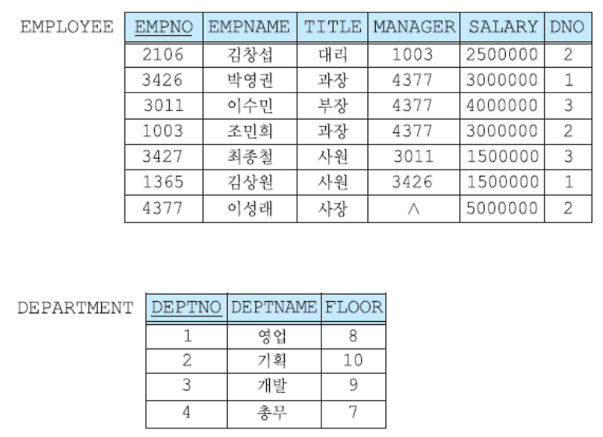
2. Data Definition Language
FOREIGN KEY constraint
  Referencing relation: EMPLOYEE; Referenced relation : DEPARTMENT
Referencing
Referencing

Slide 25
2. Data Definition Language
FOREIGN KEY constraint
  Syntax
    CONSTRAINT FK_name
    FOREIGN KEY (FK_attribute) REFERENCES parent_relation(PK_attribute)
  Example
    CREATE TABLE employee(
    empno int NOT NULL,
    empname varchar(45),
    title varchar(45),
    manager int,
    salary int,
    dno int,
    CONSTRAINT PK_Employee PRIMARY KEY (empno),
    CONSTRAINT FK_Employee_Manager
    FOREIGN KEY (manager) REFERENCES employee(empno),
    CONSTRAINT FK_Department_Employee
    FOREIGN KEY (dno) REFERENCES department(deptno)
    );

Slide 26
2. Data Definition Language
FOREIGN KEY constraint
  To drop FOREIGN KEY constraint
    ALTER TABLE employee
    DROP FOREIGN KEY FK_Department_Employee;
  To add FOREIGN KEY constraint
    ALTER TABLE employee
    ADD CONSTRAINT FK_Department_Employee
    FOREIGN KEY (dno) REFERENCES department(deptno);

Slide 27
2. Data Definition Language
Summary
  Referencing relation: EMPLOYEE; Referenced relation : DEPARTMENT
Referencing
2. Create EMPLOYEE table
Referencing
1. Create DEPARTMENT table

Slide 28
2. Data Definition Language
Summary
  First create DEPARTMENT table with PRIMARY KEY constraint
  DEPARTMENT Table
    CREATE TABLE department(
    deptno int NOT NULL,
    deptname varchar(45) NOT NULL,
    floor int,
    CONSTRAINT PK_Department PRIMARY KEY (deptno)
    );

Slide 29
2. Data Definition Language
Summary
  Then create EMPLOYEE table with FOREING KEY constraint
    CREATE TABLE employee(
    empno int NOT NULL,
    empname varchar(45),
    title varchar(45)
    manager int,
    salary int,
    dno int,
    CONSTRAINT PK_Employee PRIMARY KEY (empno),
    CONSTRAINT FK_Employee_Manager
    FOREIGN KEY (manager) REFERENCES employee(empno),
    CONSTRAINT FK_Department_Employee
    FOREIGN KEY (dno) REFERENCES department(deptno)
    );

Slide 30
3. Data Manipulation Language
Data Manipulation Language (DML)
  A language for searching, modifying, inserting and deleting the desired data in the database
    DML also known as query language
  Statements
    INSERT
    UPDATE
    DELETE
    SELECT

Slide 31
3. Data Manipulation Language
The INSERT INTO statement
  Used to insert tuples into the relation
  Specify both the attributes names and the values to be inserted
    INSERT INTO relation_name (attribute1, attribute2, attribute3, ...) VALUES (value1, value2, value3, ...);
  If you are adding values for all the attributes of the relation, you do not need to specify the attribute names in the SQL query
    INSERT INTO relation_name
    VALUES (value1, value2, value3, ...);

Slide 32
3. Data Manipulation Language
The INSERT INTO statement
  Example of inserting a single tuple
    INSERT INTO department (deptno, deptname, floor)
    VALUES (1, '영업', 8);
  Example of inserting multiple tuples
    INSERT INTO department
    (deptno, deptname, floor)
    VALUES
    (2, '기획', 10),
    (3, '개발', 9),
    (4, '충무', 7);

Slide 33
3. Data Manipulation Language
The INSERT INTO statement
  The INSERT INTO statement without attribute names
    INSERT INTO employee
    VALUES
    (4377, '이성래', '사장', NULL, 5000000, 2),
    (3011, '이수민', '부장', 4377, 4000000, 3),
    (3426, '박영권', '과장', 4377, 3000000, 1),
    (1003, '조민희', '과장', 4377, 3000000, 2),
    (2106, '김창섭', '대리', 1003, 2500000, 2),
    (3427, '최종철', '사원', 3011, 1500000, 3),
    (1365, '김상원', '사원', 3426, 1500000, 1);

Slide 34
3. Data Manipulation Language
The UPDATE statement
  Used to modify the existing tuples in a relation
    UPDATE relation_name
    SET attribute1 = value1, attribute2 = value2, ...
    WHERE condition;
  Example: Suppose that a person with an employee number 1365 received the promotion from '사원' to '대리' and his salary is increased from 1500000 to 2500000. Use UPDATE statement to make this change:
    UPDATE employee
    SET title = '대리', salary = 2500000
    WHERE empno = 1365;

Slide 35
3. Data Manipulation Language
The DELETE statement
  Used to delete existing tuples in a relation
    DELETE FROM relation_name WHERE condition;
  Example: Suppose that a person with an employee number 2106 quit the job. Use DELETE statement to remove the tuple related to 2106
    DELETE FROM employee WHERE empno = 2106;

Slide 36
3. Data Manipulation Language
The SELECT statement
  Used to select/retrieve tuples from a database
  Syntax
    SELECT [DISTINCT] attribute(s) (1)
    FROM relation(s) (2)
    [WHERE condition] (3)
    [GROUP BY attribute(s)] (4)
    [HAVING condition] (5)
    [ORDER BY attribute(s)] (6)
    [LIMIT number]; (7)
Compulsory
Optional

Slide 37
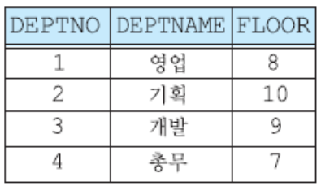
3. Data Manipulation Language
The SELECT statement
  Example: Select all attributes of department relation
    SELECT deptno, deptname, floor
    FROM department;
    SELECT *
    FROM department;

Slide 38
3. Data Manipulation Language
The INSERT INTO SELECT statement
  Copies data from one table and inserts it into another table
  Example
    INSERT INTO Customers (CustomerName, City, Country)
    SELECT SupplierName, City, Country FROM Suppliers;
The SELECT INTO statement
  Copies data from one table and inserts it into a new table
  Example
    SELECT * INTO CustomersBackup2017
    FROM Customers;

Slide 39
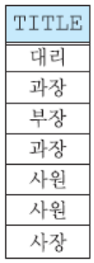
3. Data Manipulation Language
The SELECT statement
  Example: Search the titles of all employees
    SELECT title
    FROM employee;

Slide 40
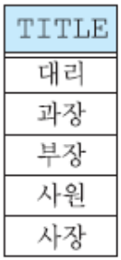
3. Data Manipulation Language
The SELECT statement
  Example: Search only distinct titles of all employees
    SELECT DISTINCT title
    FROM employee;

Slide 41
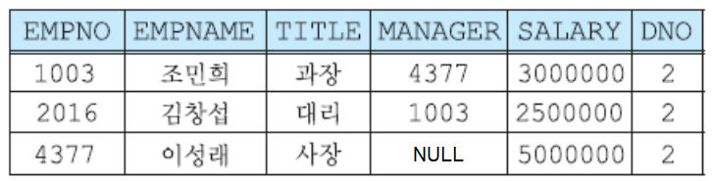
3. Data Manipulation Language
The SELECT statement
  Example: Retrieve all information about employees in department 2
    SELECT *
    FROM employee
    WHERE DNO = 2;

Slide 42
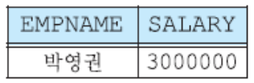
3. Data Manipulation Language
The SELECT statement – AND operator
  The AND operator displays a tuple if all the conditions separated by AND are TRUE
  Example: Search for the names and salaries of employees with a manager position and working in department 1
    SELECT empname, salary
    FROM employee
    WHERE title = '과장' AND dno = 1;

Slide 43
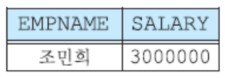
3. Data Manipulation Language
The SELECT statement – AND operator
  Example: Search for the names and salaries of employees whose job title is a manager and do not belong to department 1
    SELECT empname, salary
    FROM employee
    WHERE title = '과장' AND dno <> 1;
    Note that in some versions of SQL, <> operator may be written as !=

Slide 44
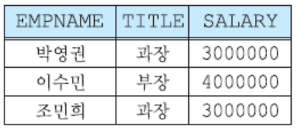
3. Data Manipulation Language
The SELECT statement – AND operator
  Example: Search for the names, positions, and salaries of employees with a salary of 3,000,000 won or more and less than 4,500,000 won
    SELECT empname, title, salary
    FROM employee
    WHERE salary BETWEEN 3000000 AND 4500000;
    SELECT empname, title, salary
    FROM employee
    WHERE salary >= 3000000 AND salary <= 4500000;

Slide 45
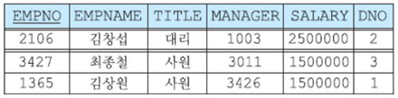
3. Data Manipulation Language
The SELECT statement – OR operator
  The OR operator displays a tuple if any of the conditions separated by OR is TRUE
  Example: Search for employees who have title '대리' or '사원'
    SELECT *
    FROM employee
    WHERE title = '대리' OR title = '사원';

Slide 46
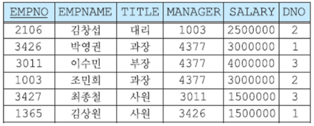
3. Data Manipulation Language
The SELECT statement – NOT operator
  The NOT operator displays a tuple if the condition(s) is NOT TRUE
  Example: Search all information related to employees except the owner
    SELECT *
    FROM employee
    WHERE NOT title = '사장';

Slide 47
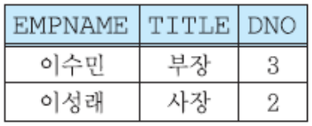
3. Data Manipulation Language
The SELECT statement – LIKE operator
  Example: Search for the names, titles, and department numbers of employees with the Lee surname
    SELECT empname, title, dno
    FROM employee
    WHERE empname LIKE '이%';

Slide 48
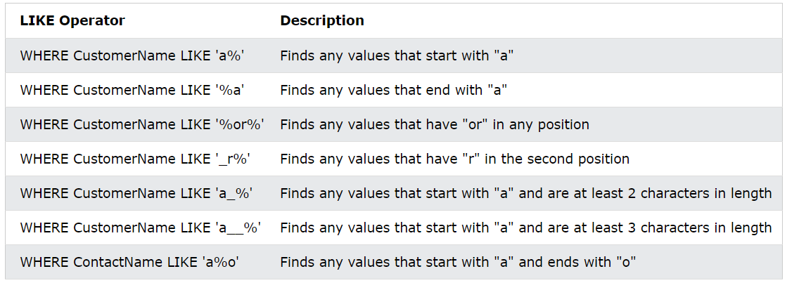
3. Data Manipulation Language
The SELECT statement – LIKE operator
  Other cases of LIKE operator with ‘%’ and ‘_’ keywords

Slide 49
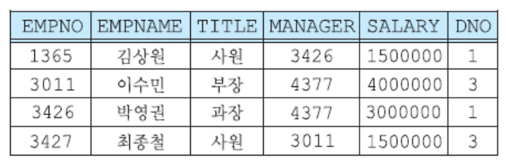
3. Data Manipulation Language
The SELECT statement – IN operator
  Example: Retrieve all information about employees belonging to department 1 or department 3
    SELECT *
    FROM employee
    WHERE dno IN (1, 3);

Slide 50
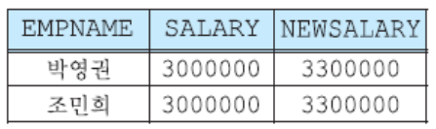
3. Data Manipulation Language
The SELECT statement – Arithmetic Operators
  Example: Retrieve the names, current salaries, and salaries increased by 10% for employees with a manager position
    SELECT empname, salary, salary * 1.1 AS newsalary
    FROM employee
    WHERE title = '과장';

Slide 51
3. Data Manipulation Language
The SELECT statement – Aggregation Functions
  Applied to one attribute of a relation and returns a single value
  Can only appear in SELECT and HAVING clauses
  Aggregation functions
    COUNT – counts the number of tuples or values
    SUM – sums the values
    AVG – returns the average of values
    MAX – returns maximum value
    MIN – returns min value

Slide 52


3. Data Manipulation Language
The SELECT statement – Aggregation Functions
  Example: Show the maximum and average salary of all employees
    SELECT AVG(salary) AS avgsalary, MAX(salary) AS maxsalary
    FROM employee;
  Example: Count all tuples in employee relation
    SELECT COUNT(*) AS allTuples
    FROM employee;
allTuples
7

Slide 53
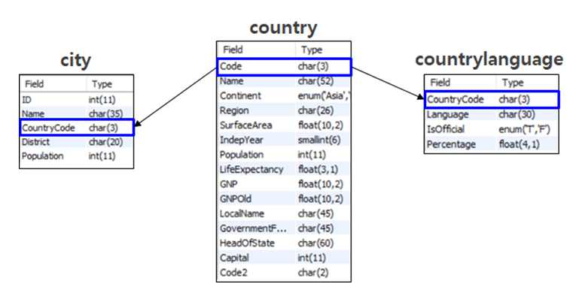
3. Data Manipulation Language
Quiz 1
  Given the following WORLD database
  Find how many languages are spoken in the USA

Slide 54
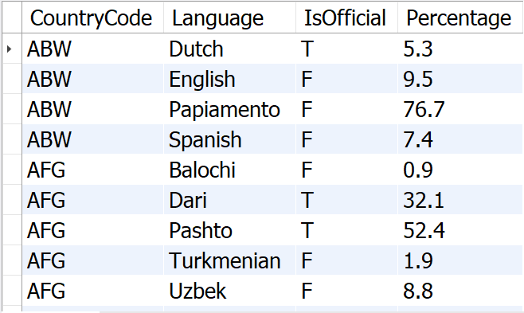
3. Data Manipulation Language
More about data

Slide 55

3. Data Manipulation Language
Answer to Query 1
  SELECT COUNT(*) AS LanguagesInUSA
  FROM CountryLanguage
  WHERE CountryCode = 'USA';

Slide 56
3. Data Manipulation Language
Quiz 2
  Given the following WORLD database
  Find total amount of languages in the world

Slide 57


3. Data Manipulation Language
Answer to Query 2: Count how many languages are in the world
  SELECT COUNT(Language)
  FROM CountryLanguage ;
Answer to Query 2: Count how many languages are in the world
  SELECT COUNT( DISTINCT Language)
  FROM CountryLanguage;

Slide 58
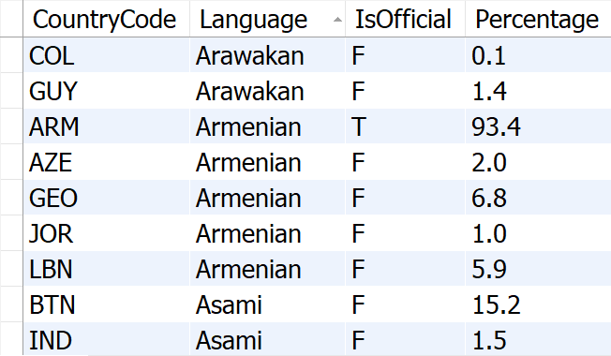
3. Data Manipulation Language
Query 2 Explanation
  There are many duplicated records in Language attribute
Duplicated Records

Slide 59
3. Data Manipulation Language
The SELECT statement
  Used to select/retrieve tuples from a database
  Syntax
    SELECT [DISTINCT] attribute(s) (1)
    FROM relation(s) (2)
    [WHERE condition] (3)
    [GROUP BY attribute(s)] (4)
    [HAVING condition] (5)
    [ORDER BY attribute(s)] (6)
    [LIMIT number]; (7)
Compulsory
Optional

Slide 60
3. Data Manipulation Language
The GROUP BY statement
  Used to group tuples with the same value in the attribute
    In the result, one tuple is created for each group
  We often use GROUP BY with aggregation functions (COUNT, SUM, AVG, MAX, MIN)
  Example: Group employees by department number, and show the department number, average salary, and maximum salary in each department
    SELECT dno, AVG(salary) as avgsal, MAX(salary) as maxsal
    FROM employee
    GROUP BY dno;

Slide 61
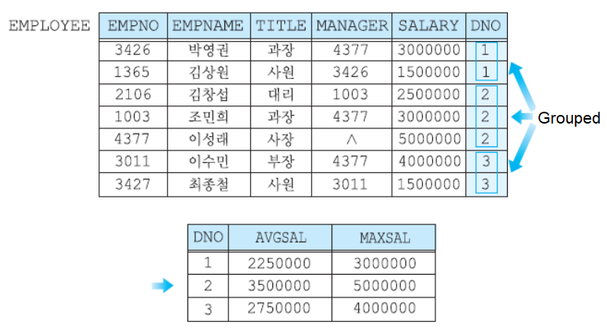
3. Data Manipulation Language
The GROUP BY statement

Slide 62
3. Data Manipulation Language
Quiz 3
  Given the following WORLD database
  How many countries speak each language

Slide 63
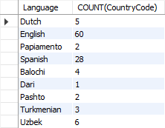
3. Data Manipulation Language
Answer to Query 3: How many countries speak each language
  SELECT Language, COUNT(CountryCode)
  FROM CountryLanguage
  GROUP BY Language

Slide 64
3. Data Manipulation Language
Quiz 3 Explanation
  Group by Language attribute: Arawakan, Armenian, Asami, etc

Slide 65
3. Data Manipulation Language
The HAVING statement
  Used to create a condition on a group of tuples
  Attributes appearing in the HAVING statement must appear in the GROUP BY clause or be included in a aggregate function
  Example: Group employees by department number, and show the department number, average salary, and maximum salary for the department with the average salary of 2,500,000 Korean Won.
    SELECT dno, AVG(salary) as avgsal, MAX(salary) as maxsal
    FROM employee
    GROUP BY dno
    HAVING avgsal >= 2500000;

Slide 66
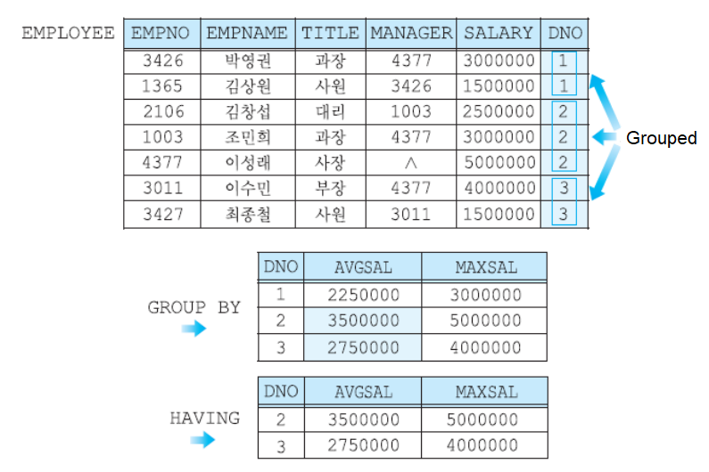
3. Data Manipulation Language
The HAVING statement

Slide 67
3. Data Manipulation Language
The ORDER BY statement
  By default, the tuples are presented to the user in the order inserted in the relation
  The ORDER BY statement is used to sort the resulting relation in ascending or descending order
  Types of ORDER BY statement
    Default sort order is ascending (ASC)
    Sort order can be specified in descending order by specifying DESC
  The null value appears first in ascending order and last in descending order

Slide 68
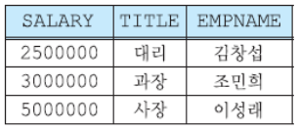
3. Data Manipulation Language
The ORDER BY statement
  Example: Search for the salary, title, and name of employees in department 2 and sort them in ascending order of salaries
    SELECT salary, title, empname
    FROM employee
    WHERE dno = 2
    ORDER BY salary;

Slide 69
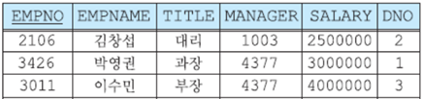
3. Data Manipulation Language
The LIMIT statement
  Used to specify the number of records to return
  The LIMIT statement is useful on large tables with thousands of records
    Returning a large number of records can impact performance
  Example: Show the first three records from the employee table
    SELECT *
    FROM employee
    LIMIT 3;

Slide 70
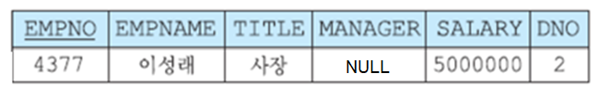
3. Data Manipulation Language
The LIMIT statement
  You can also use LIMIT to show the top or the bottom tuples
  Example: Show an employee with the highest salary
    SELECT *
    FROM employee
    ORDER BY salary DESC
    LIMIT 1;

Slide 71
3. Data Manipulation Language
Quiz 4
  Given the following WORLD database
  Find languages that are spoken in at least 3 different countries with percentage at least 50

Slide 72
3. Data Manipulation Language
More about data

Slide 73
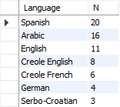
3. Data Manipulation Language
Answer to Query 4: Find languages that are spoken in at least 3 different countries with percentage at least 50.
  SELECT Language, COUNT(CountryCode) AS N
  FROM CountryLanguage
  WHERE Percentage >= 50
  GROUP BY Language
  HAVING N > 2
  ORDER BY N DESC ;

Slide 74
4. Summary and Discussions
Data Definition Language (DDL)
  Notation for defining the database schema
    Used to create and modify the structure of your relations and database objects
  Statements
    CREATE
    DROP
    ALTER
    TRUNCATE

Slide 75
4. Summary and Discussions
MySQL constraints
  SQL constraints are used to specify rules for the data in a relation
  MySQL constraints
    NOT NULL
    PRIMARY KEY
    FOREIGN KEY
    UNIQUE
    CHECK
    DEFAULT

Slide 76
4. Summary and Discussions
Data Manipulation Language (DML)
  A language for searching, modifying, inserting and deleting the desired data in the database
    DML also known as query language
  Statements
    INSERT
    UPDATE
    DELETE
    SELECT

Slide 77
4. Summary and Discussions
The SELECT statement
  Used to select/retrieve tuples from a database
  Syntax
    SELECT [DISTINCT] attribute(s) (1)
    FROM relation(s) (2)
    [WHERE condition] (3)
    [GROUP BY attribute(s)] (4)
    [HAVING condition] (5)
    [ORDER BY attribute(s)] (6)
    [LIMIT number]; (7)
Compulsory
Optional

